Slide 1
SENTIMENTAL ANALYSIS OF TWITTER DATA
CPSC 481-01 (20712)
Presented By:
ROHIT SAHA
Guided By:
Dr. Wenlin Han

Slide 2
AGENDA
Introduction
Project Objective
What is Sentimental Analysis
Project Overview
Software and Libraries used
System Architecture
Project Walk through
Demo
Algorithm comparison
Graphical representation of the result
Significance
What We Learned
Conclusion and Implication

Slide 3
INTRODUCTION
Twitter is a popular microblogging website.
Each tweet has almost 140 characters in length.
Tweets are frequently used to express tweeter’s emotion on a particular object.
There are organizations which hire twitter for analyzing sentiments on a particular subject. This sentimental analysis helps determining future strategies.
Notes:
Twitter is a social networking website where users post and interacts with tweets. User tweets are frequently used express emotion

Slide 4

OBJECTIVE OF THE PROJECT
To implement an algorithm for classifying tweets into positive, negative or neutral
Using Sentimental analysis to determine the attitude of the mass, whether positive, negative, or neutral towards a specific topic.
Representing the analysis result graphically for its better understanding and correct decision making.
Notes:
Determine whether the writers attitude is positive negative or neutral

Slide 5




SENTIMENTAL ANALYSIS…..??
Sentiment analysis (also known as opinion mining or emotion AI) refers to the use of natural language processing, text analysis, computational linguistics, and biometrics to systematically identify, extract, quantify, and study affective states and subjective information. The process of computationally identifying and categorizing opinions expressed in a piece of text, especially in order to determine whether the writer's attitude towards a particular topic, product, etc. is positive, negative, or neutral.
negative
positive
neutral
Notes:
The process of computationally identifying and categorizing opinion expressed in the piece of text

Slide 6
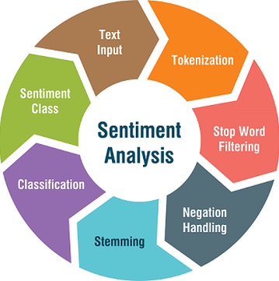
PROJECT OVERVIEW

Slide 7
SOFTWARE AND LIBRARIES USED
Python(Backend)
Javascript & HTML(frontend)
Libraries:
json - Support .json
re - Regular Expression
panda - Matrices
numpy - Scientific computing and graph
nltk - Natural Language Processing
sklearn - Machine learning and statistical algorithms and computation
Matpotlib – Utiliized for graphical representation of the test data

Slide 8
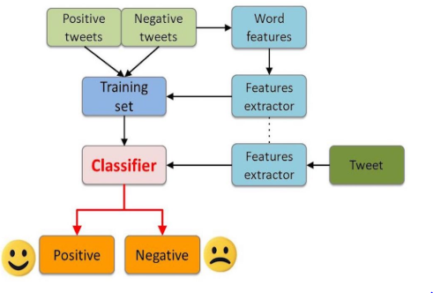
SYSTEM ARCHITECTURE

Slide 9
PROJECT WALK-THROUGH
Section A: Preparing The Test Set
Twitter API has been used to extract tweets based on the topic specified by the user. The test set contains the tweet_id and tweet text for 1000 tweets specific to the user defined topic. The data is loaded as json data.
Section B: Preparing The Training Set
The training data set is a collection of 1600000 tweets containing tweet_id, tweet text and tweet sentiment. The data from the training data set is loaded into a json object for processing
Section C: Pre-processing Tweets in The Data Sets
The training and the test data set, both require Pre-processing. This is the most important data mining technique that involves transforming raw data into an understandable format. Real-world data is often incomplete, inconsistent, and/or lacking in certain behaviors or trends, and is likely to contain many errors. Data preprocessing is a proven method of resolving such issues.

Slide 10
PROJECT WALK-THROUGH CONTD..
Section D: Training the classifier
Vocabulary is built from the training dataset and tweets are matched against them to develop the feature vector. This technique is used to train the classifier.
Section E: Testing The Model
We have used NAÏVE BAYES, SUPPORT VECTOR MACHINES AND NATURAL LANGUAGE PROCESSING to perform sentimental analysis on the test data, calculate and compare the accuracy of the result

Slide 11
Demo

Slide 12
ALGORITHM COMPARISON
Algorithm | NAÏVE BAYES | SVM | NLP
Runtime (Sec) | 53.49 | 56.93 | 54.23
Standard Deviation | 0.1874 | 1.4859 | 2.6737
Accuracy | 64 | 67 | 60

Slide 13
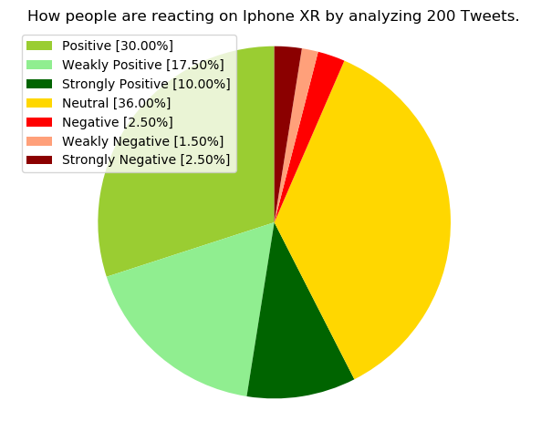
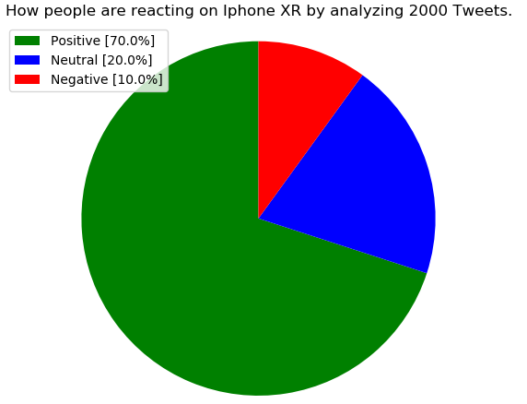
GRAPHICAL REPRESENTATION OF THE RESULT
NLP(Natural Language Processing
Naïve Bayes

Slide 14
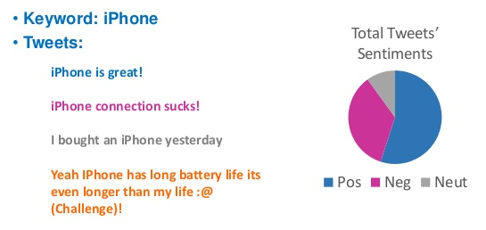
GRAPHICAL REPRESENTATION OF THE RESULT
Support Vector Machines(SVM)

Slide 15
SIGNIFICANCE
Application allows user to perform sentimental analysis on any topic/ person to get review on the same
This System can be used by many organizations to decide business strategies and get product reviews.
Based on the analysis appropriate action can be taken going forward.

Slide 16
What We Learned
How to clean and process data in required format.
Different Machine Learning Algorithms and their significances.
Training Model and making analysis.
Solving Daily life issue in more efficient way.

Slide 17
Conclusion and Implication
Python is used for its ease of understanding and robustness
The objective of our project is to get latest review for any item on the basis of tweets posted on the same
The analysis plays very important role in reviewing a product and developing future improvements based on user reviews

Slide 18
Thank You!

